Slide 1

MSCI 311
Organizational Design and Technology
Instructor: Ayman Alzayat, aalzayat@uwaterloo.ca
TA: Varsha Suryanarayana, vsuryana@uwaterloo.ca

Slide 2
Technology
Technology
Joan Woodward:
Unit, batch, and process
Technology & Structure
Charles Perrow:
Task Variety and Analyzability
J. D. Thompson:
Task Interdependence
The Socio-Technical View

Slide 3

Technology

Slide 4
Technology
Definition
Technology = “knowledge, tools, techniques, and behavior used to transform org. inputs into org. outputs”
Operations technology: machines, equipment, instruments
Information technology: information that is received, generated, and analyzed

Slide 5
Technology
Importance of technology
Tasks
Technology affects job design
Productivity
New technology to increase productivity
Organizational Design (to be discussed later in this module)

Slide 6
Technology and Structure
Technical Complexity (Woodward)
Study (1950s) on many manufacturing firms
Unit of analysis: core operating technology of the organization
Complexity is measured through two factors:
Technical complexity is a measure of the extent to which a production process can be programmed so that it can be controlled and made predictable.
Production volume

Slide 7
Technology and Structure
Technical Complexity (Woodward)
Three groupings of technology:
1- Unit (and small batch).
2- Mass (and large batch).
3- Process.

Slide 8
Technology and Structure
Technical Complexity (Woodward)
1- Unit (and small batch):
Small quantity, custom made products
Worker skill and knowledge important
Unpredictable, time-consuming process
E.g. custom furniture, prototypes

Slide 9
Technology and Structure
Technical Complexity (Woodward)
2- Mass (and large batch) Production:
Standardized output, using assembly line
Processes are routine, repetitive, and predictable
Highly automated production, small impact of workers
Large, efficient production that lowers unit price
E.g. cars in an assembly line,

Slide 10
Technology and Structure
Technical Complexity (Woodward)
Three groupings of technology:
3- Continuous Process production
Highly mechanized
Processes are continuous, repetitive, and endless
Highest degree of standardization
E.g. oil refinery

Slide 11
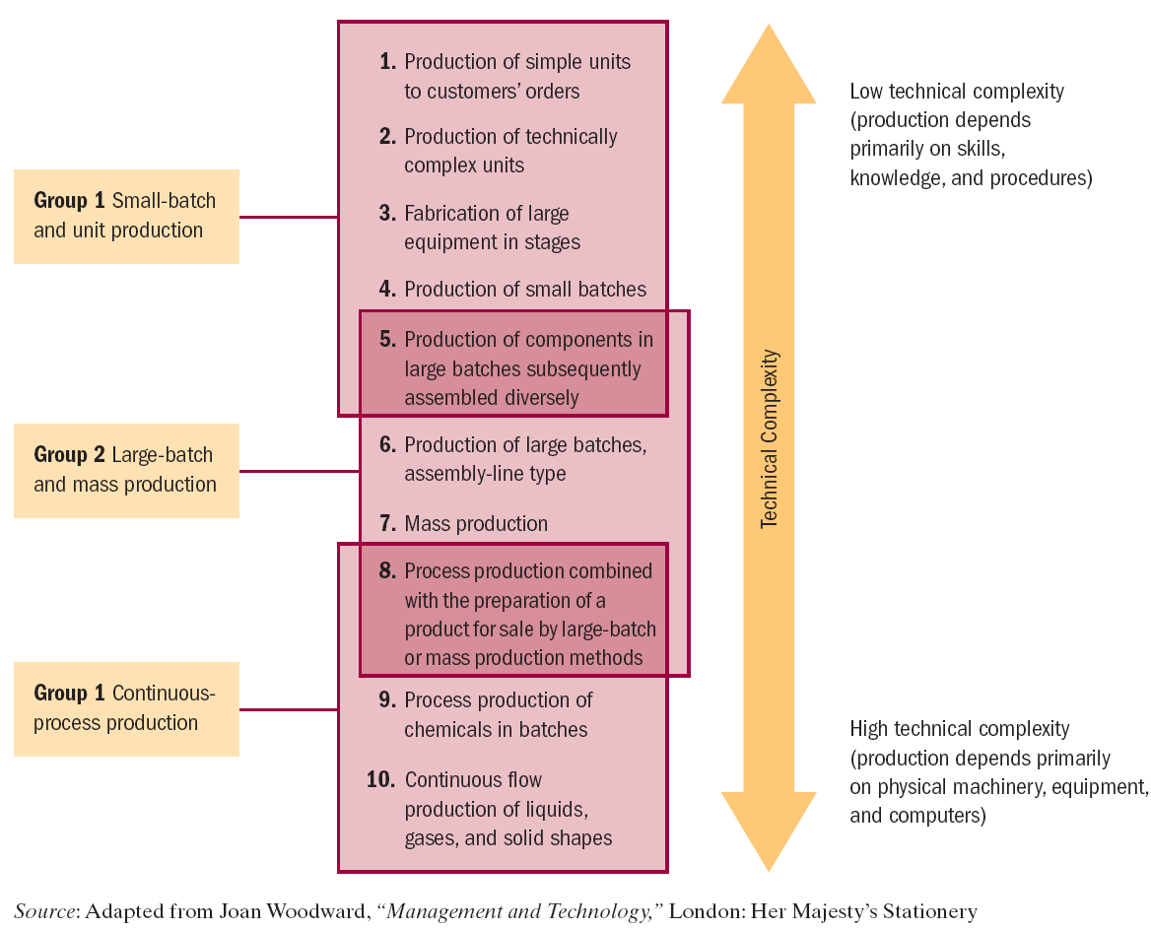

Slide 12
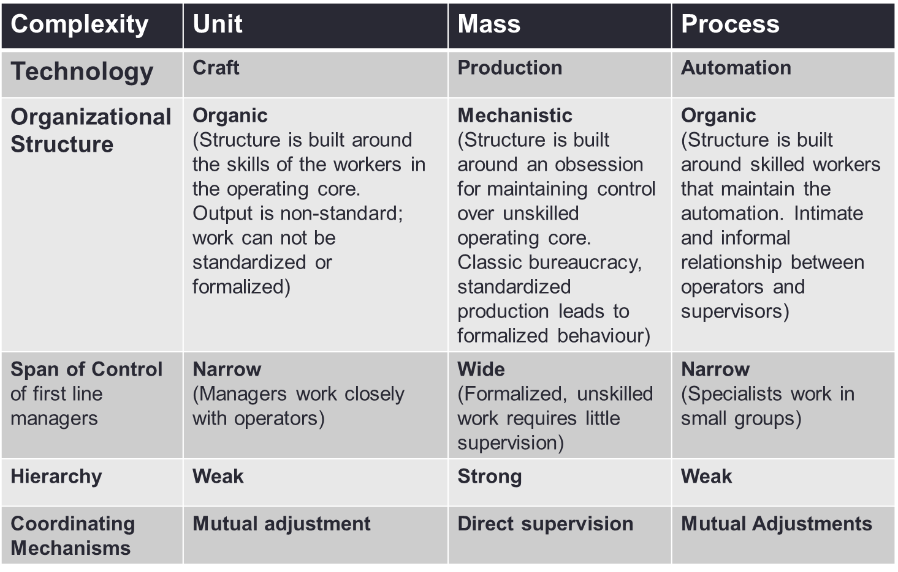

Slide 13
Technology and Structure
Task Variety & Analyzability (Perrow)
Extend concepts beyond manufacturing (e.g. services)
Unit of analysis: work unit tasks
Two dimensions of technology:
1. Task Variety = “The number of exceptions to the planned course of events”
2. Task Analyzability = “Extent to which task can be reduced to explicit steps, techniques, instructions, and programs” E.g. catching a ball vs. typing a sentence

Slide 14
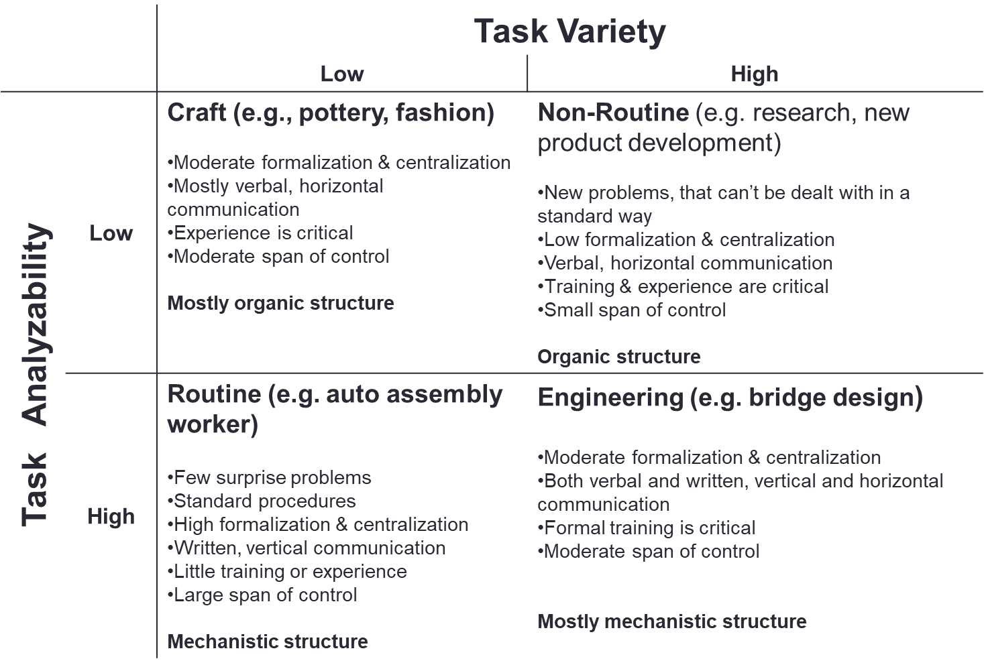


Slide 16
Technology and Structure
Task Interdependence (Thompson)
Types of internal interdependencies amongst organizational parts:
Pooled interdependence
Sequential interdependence
Reciprocal interdependence
Task interdependence refers to the manner in which different organizational tasks are related to one another. According to this view, when task interdependence is low, people and departments are individually specialized. When task interdependence is high, people and departments are jointly specialized.

Slide 17
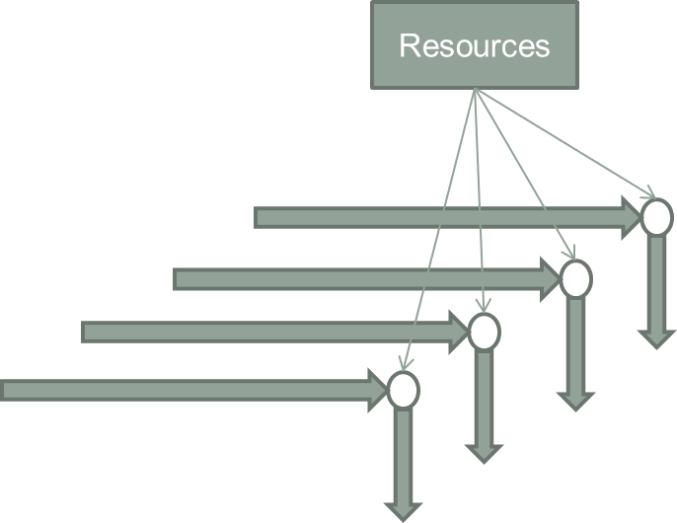
Technology and Structure
Task Interdependence (Thompson)
1. Pooled interdependence
Org. parts share resources
Failure of one can jeopardize the whole and thus the other parts -> increase parts
E.g. teachers in a school, commercial banks, real estate companies
Makes use of “Mediating Technology” (e.g. bank machine. Link units that would otherwise be independent (customer & bank))

Slide 18
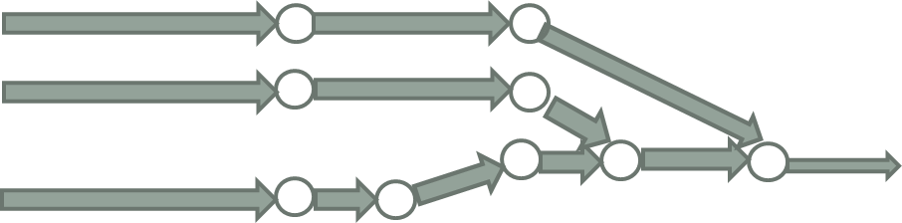
Technology and Structure
Task Interdependence (Thompson)
2. Sequential interdependence
Pooled aspect present: all parts make contributions to the whole and they are sustained by the whole
In addition: Serial configuration, output of one part becomes input to another
E.g. mass production factory
Makes use of “Long-Linked Technology” (e. g. assembly line)
This system has two major disadvantages:
Employees do not become highly skilled
must follow the specified procedures

Slide 19
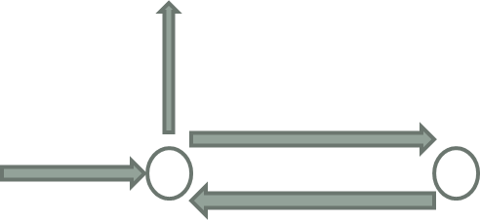
Technology and Structure
Task Interdependence (Thompson)
3. Reciprocal interdependence
Presence of pooled & serial task interdependence
In addition: Outputs of each task become inputs for the other tasks
E.g., airline operations and maintenance units, nurses and surgeons in operating room
Makes use of “Intensive Technology”

Slide 20
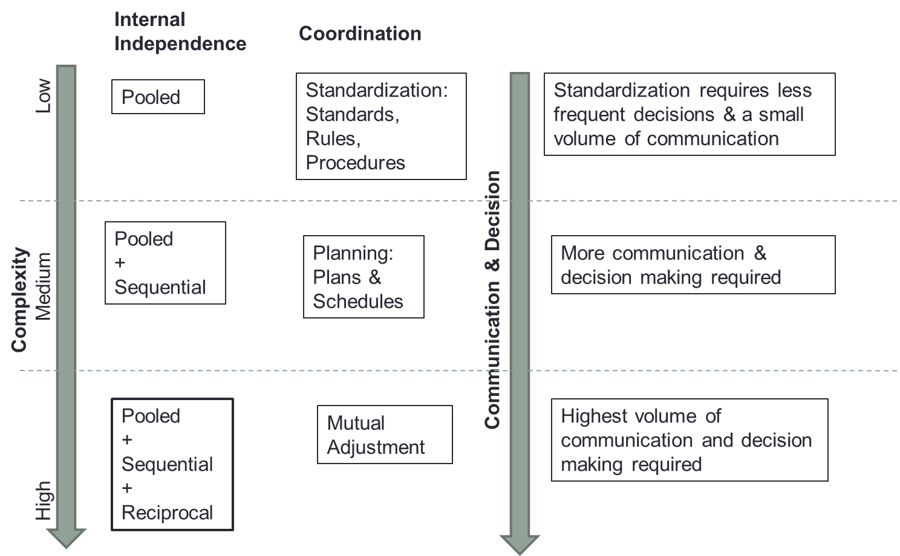
Technology and Structure
Task Interdependence (Thompson)

Slide 21
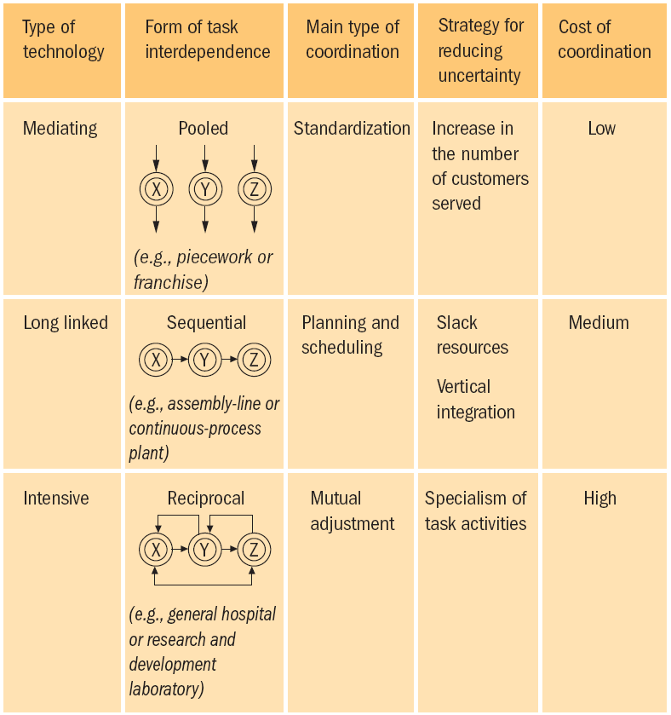
Technology and Structure
Task Interdependence (Thompson)

Slide 22
Technology and Structure
General criticism of the three typologies (Woodward, Perrow, Thompson)
There exist linkages between technology and structure
Can’t be sure that the former dictates the latter
Technologies are complex and may be interpreted differently by different users
Different possible structures and social arrangements can emerge from the use of the same technology
Need for a view that integrates technology with social systems

Slide 23
Technology & social systems
The socio-technical view of technology
Original study in Britain (Cole mind workers)
Lager scale studies in Sweden
Impact on satisfaction
Impact on quality
Impact on productivity

Slide 24
Technology & social systems
Impact of technology on job design
Technology may increase specialization and reduce the job-cycle (e.g. assembly line worker)
Positive: increase efficiency, productivity, reduce training
Negative: Boredom and loss of concentration
Techniques to ‘fix’ the problem
Job Rotation
Job Enlargement
Job Enrichment – make the job more meaningful and autonomous

